Slide 1


PROJECT CATASCHEVASTICA
From an Online Transaction Database (OLTP) to a Data Warehouse (DW)
TEAM 5
Giarmas Nikos
Kakalis Loukas
Michailidis Giorgos
Mistiloglou Charis
Tzimi Katerina

Slide 2


Cataschevastica
3
Executive Summary
7
To Data Warehouse
Table of contents
4
8
Project Development Roles
Azure Data Lake and Databricks
5
From OLTP
9
Power BI visualisation
6
To Staging Area
10
Questions

Slide 3

Cataschevastica
Executive Summary
The previously designed Cataschevastica Online Transaction Processing (OLTP) Database, aimed at managing transactional workloads in the company’s real-time or near real-time operations, serves as the foundation for this project. The focus now shifts to constructing a Data Warehouse (DW) tailored for in-depth analytical tasks. Fact and dimension tables were created into a DW framework, Extract Load Transformation (ETL) processes were executed and analytical computations and visualizations were generated alongside with managerial dashboards. Also, data from multiple factories were aggregated into a delta lake managed by Databricks for comprehensive analysis. Finally, Power BI Desktop was utilized to craft visual reports and dashboards.

Slide 4

Project Development Roles
Business Analysts
Giarmas Nikos
Tzimi Katerina
Data Engineers
Mistiloglou Charalampos
Michailidis Georgios
Project Manager
Kakalis Loukas
Product Owner
Instructor

Slide 5
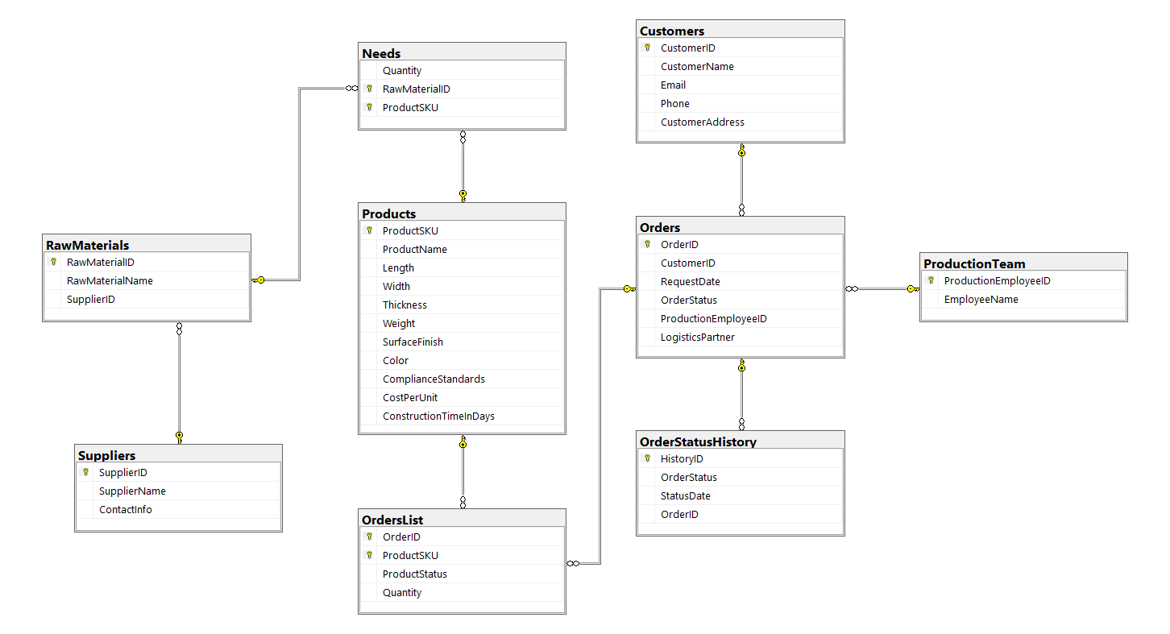
Cataschevastica
From OLTP

Slide 6
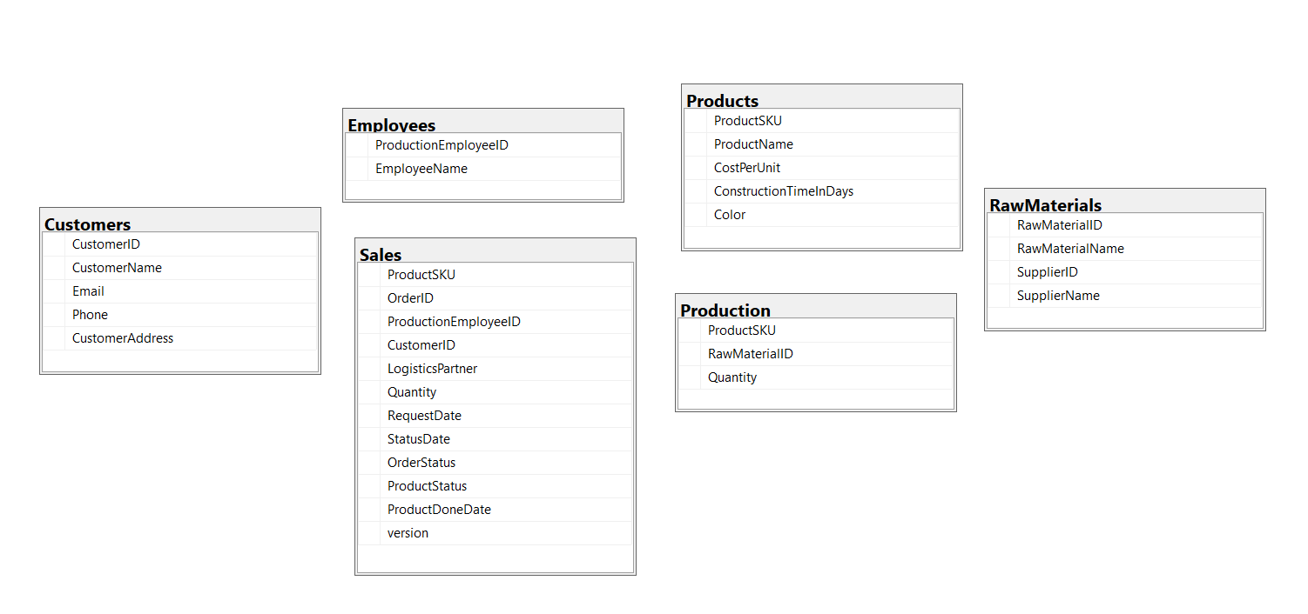

To Staging Area

Slide 7
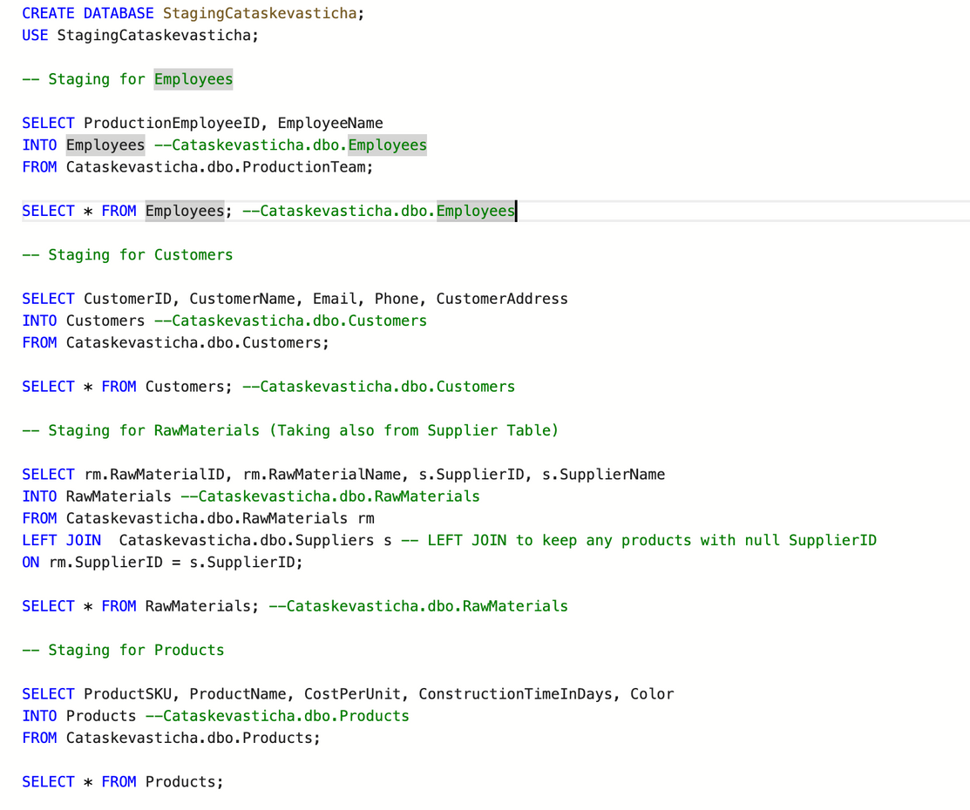
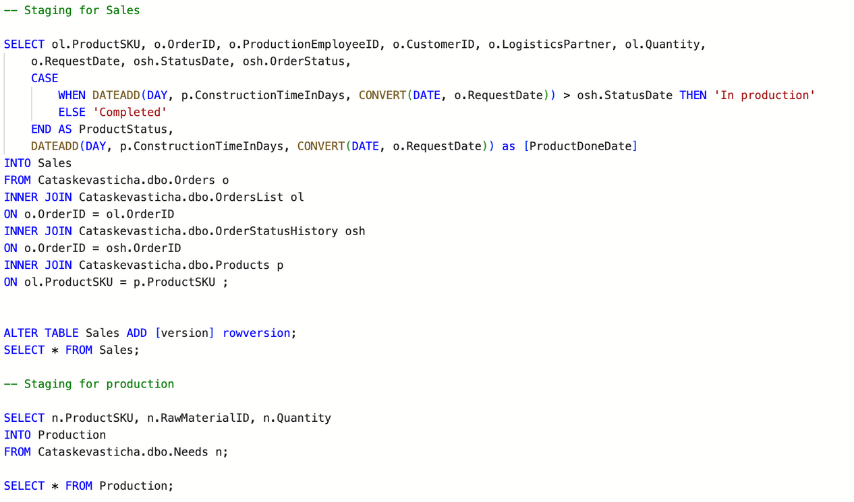
To Staging Area

Slide 8
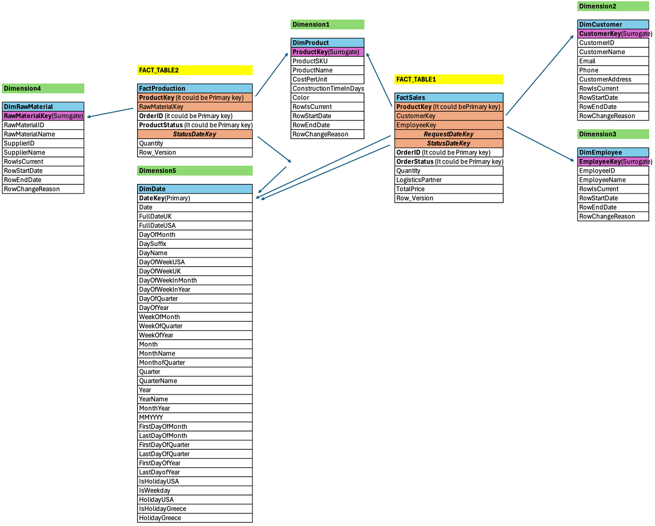
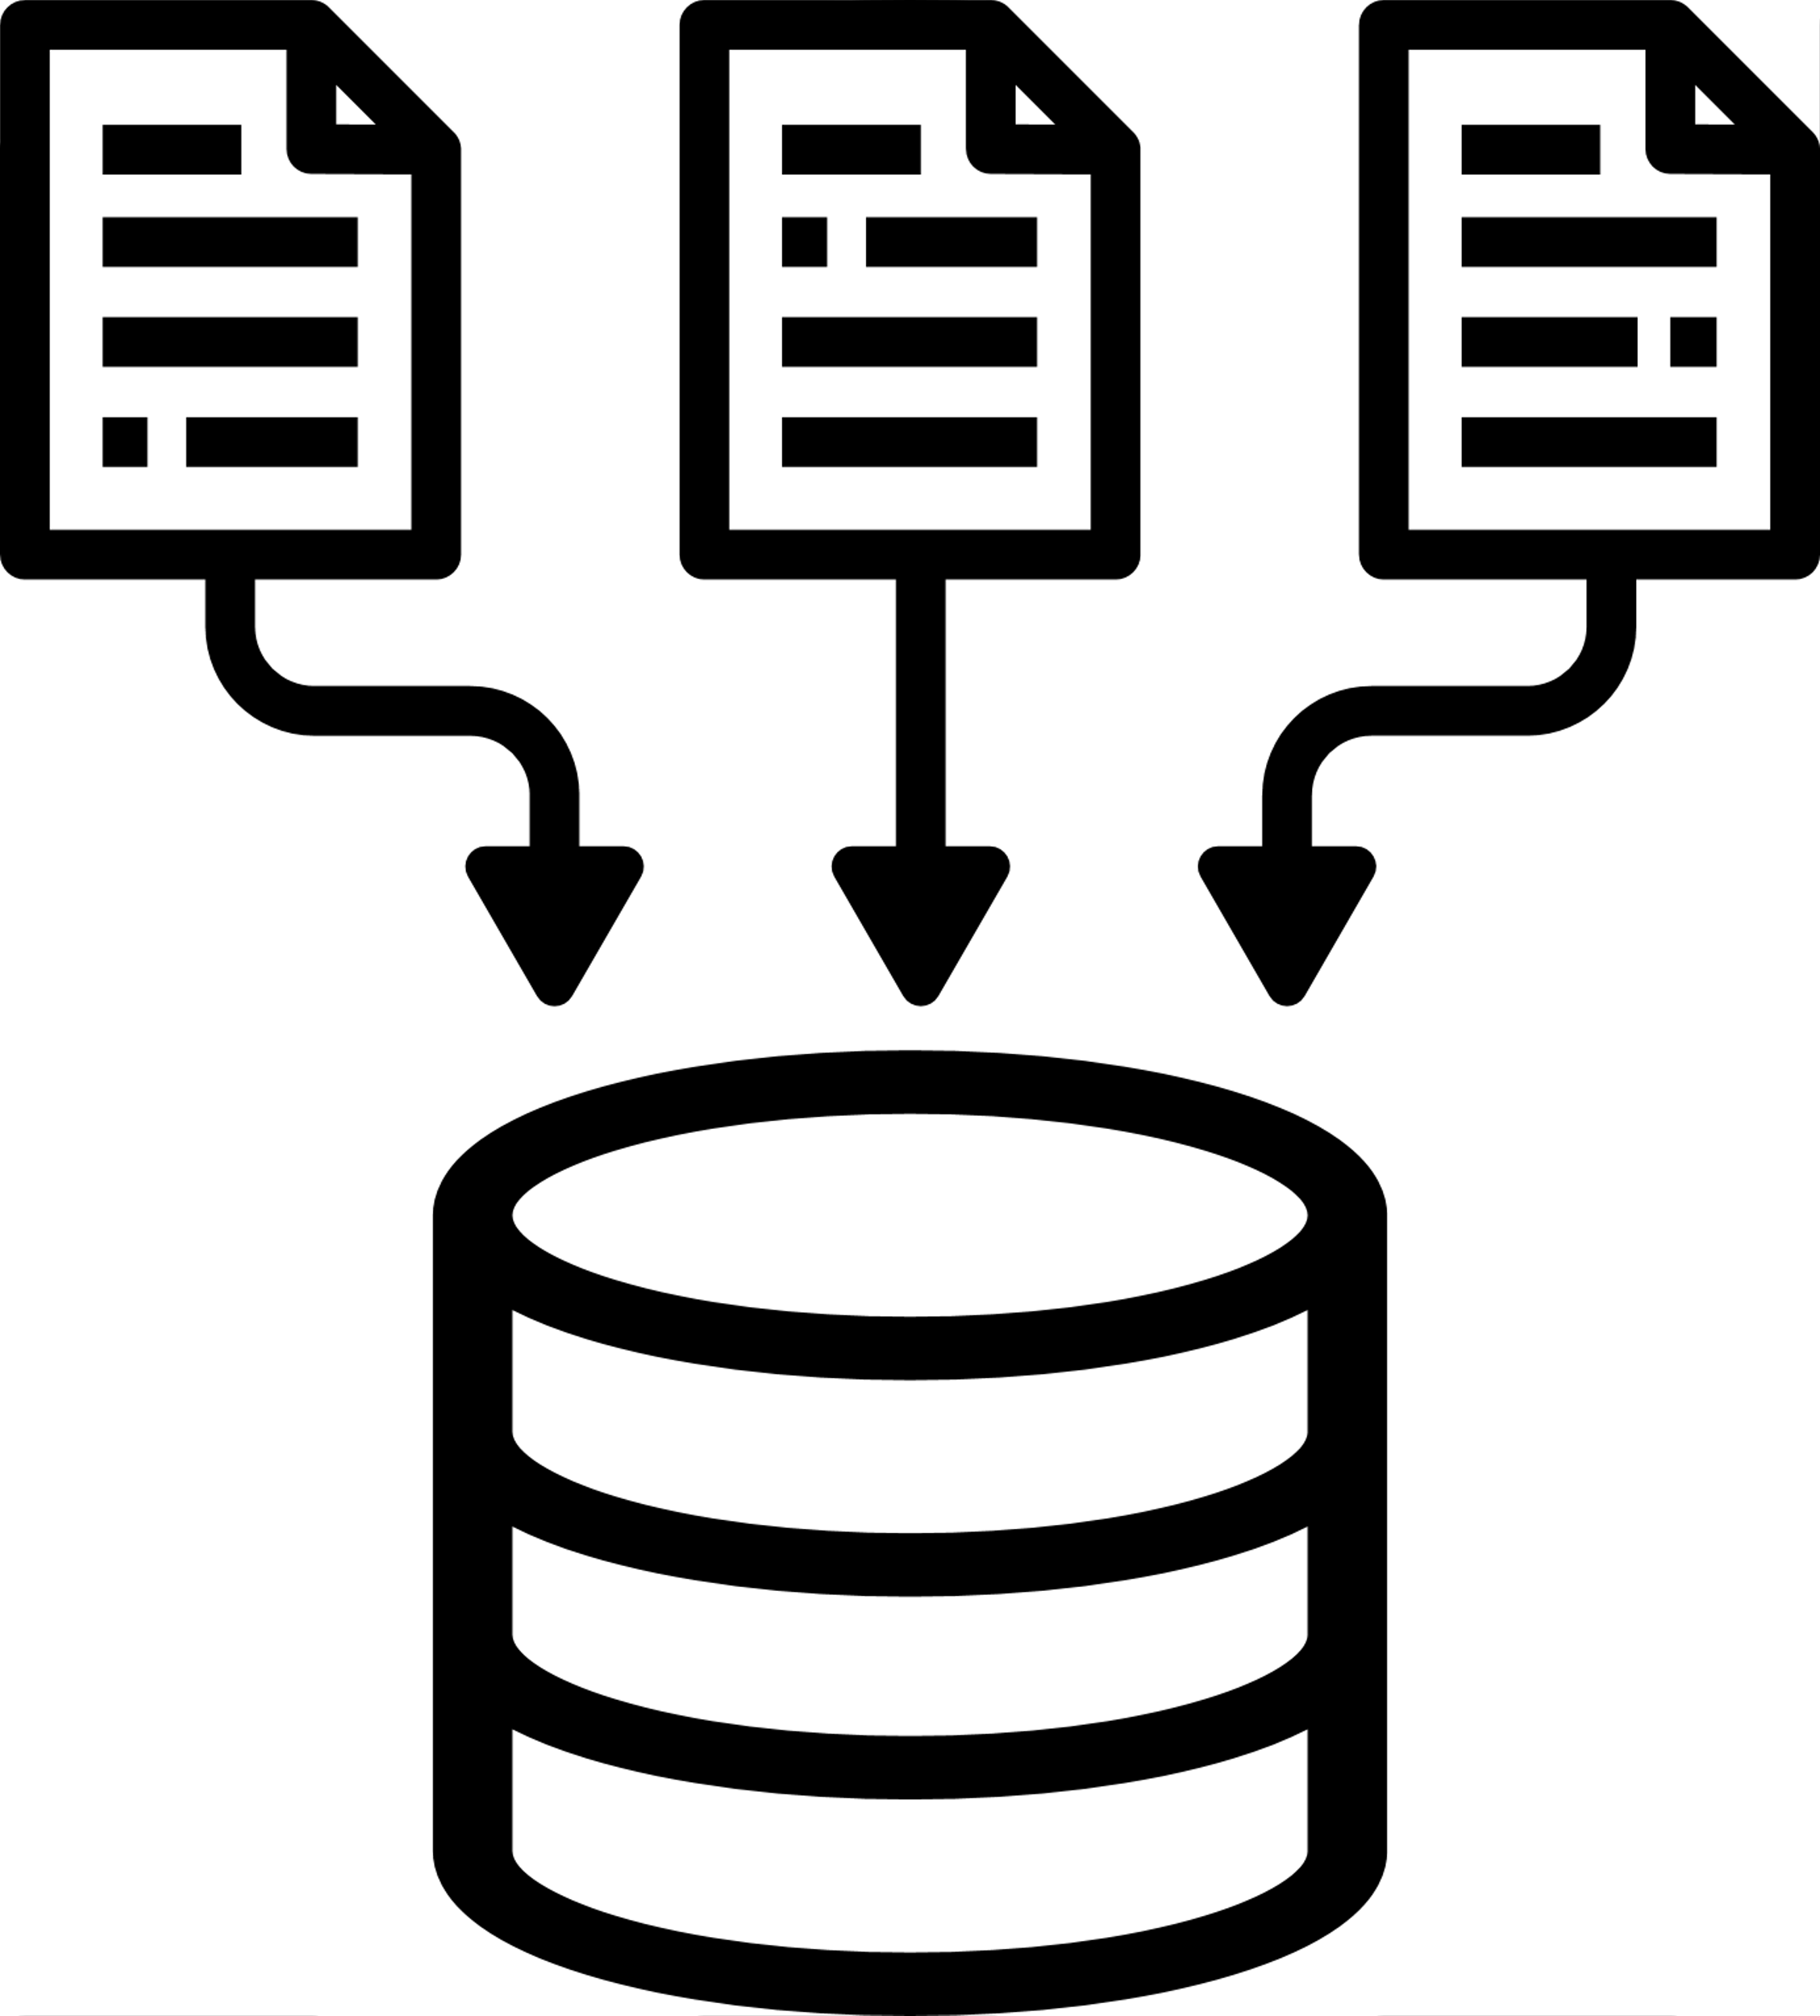
To Data Warehouse (DW)

Slide 9
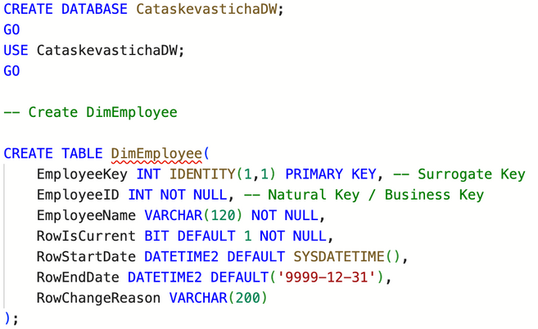
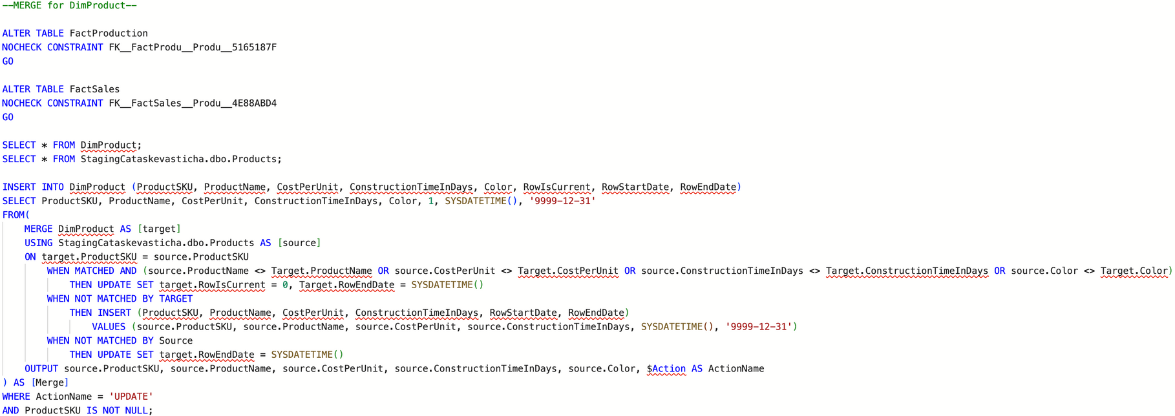
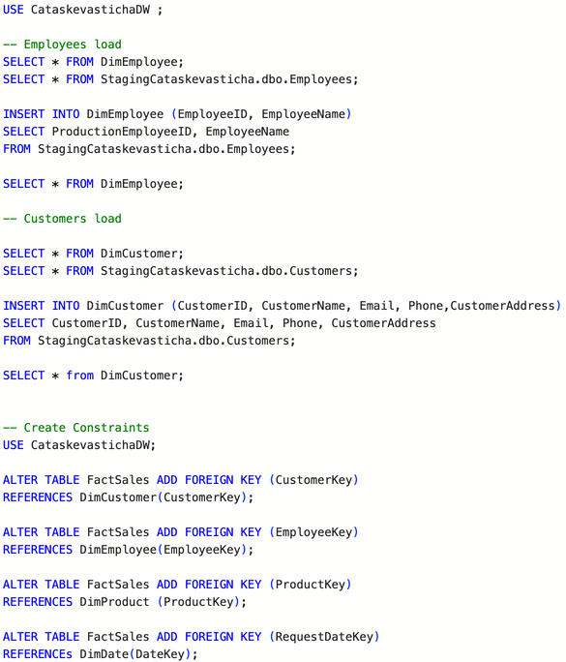
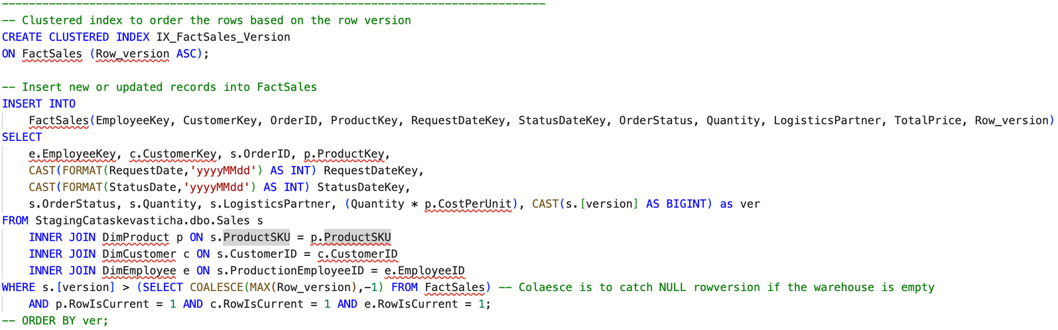
Cataschevastica DW
Cataschevastica DW
Merge Cataschevastica DW
Loading Cataschevastica DW
Incremental Loading

Slide 10
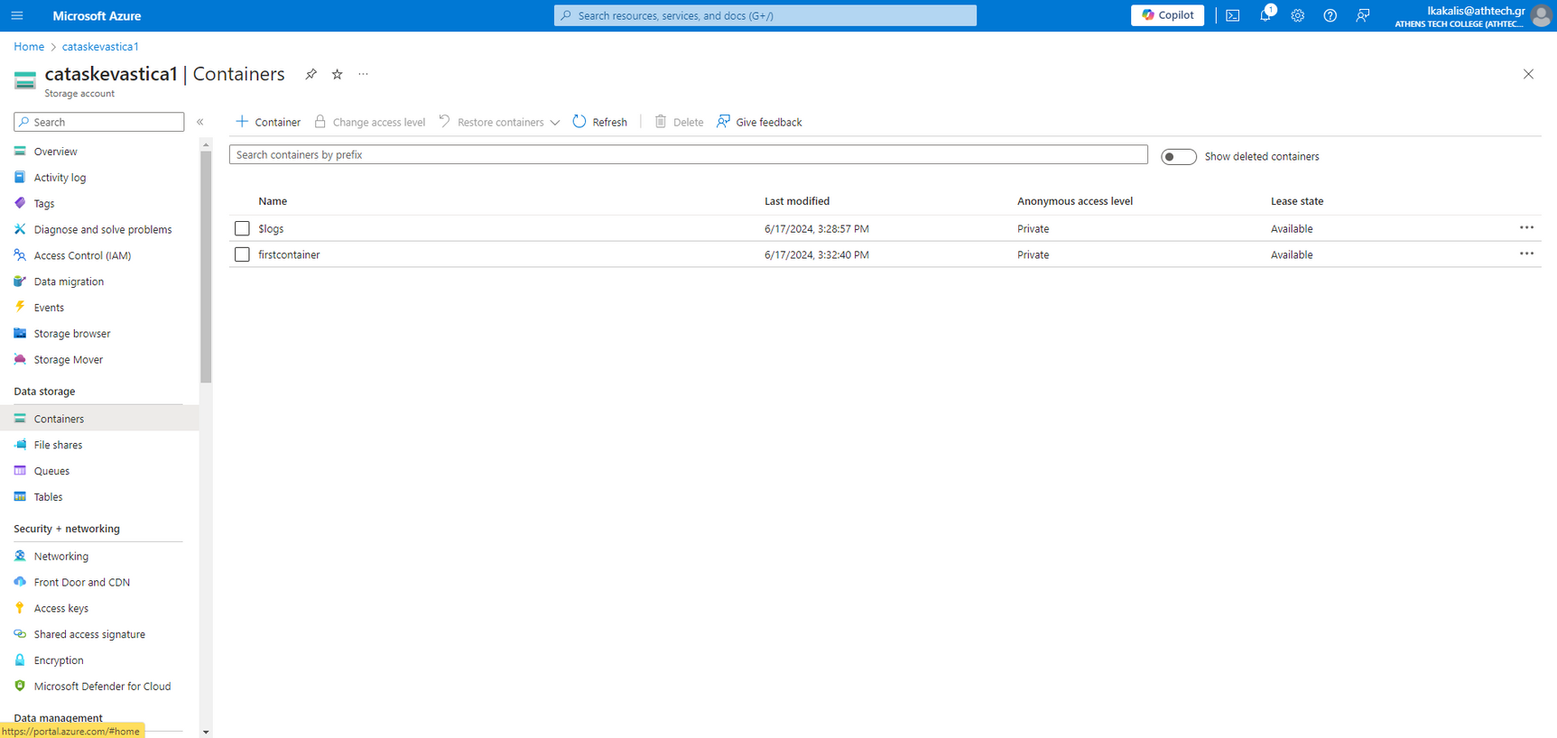
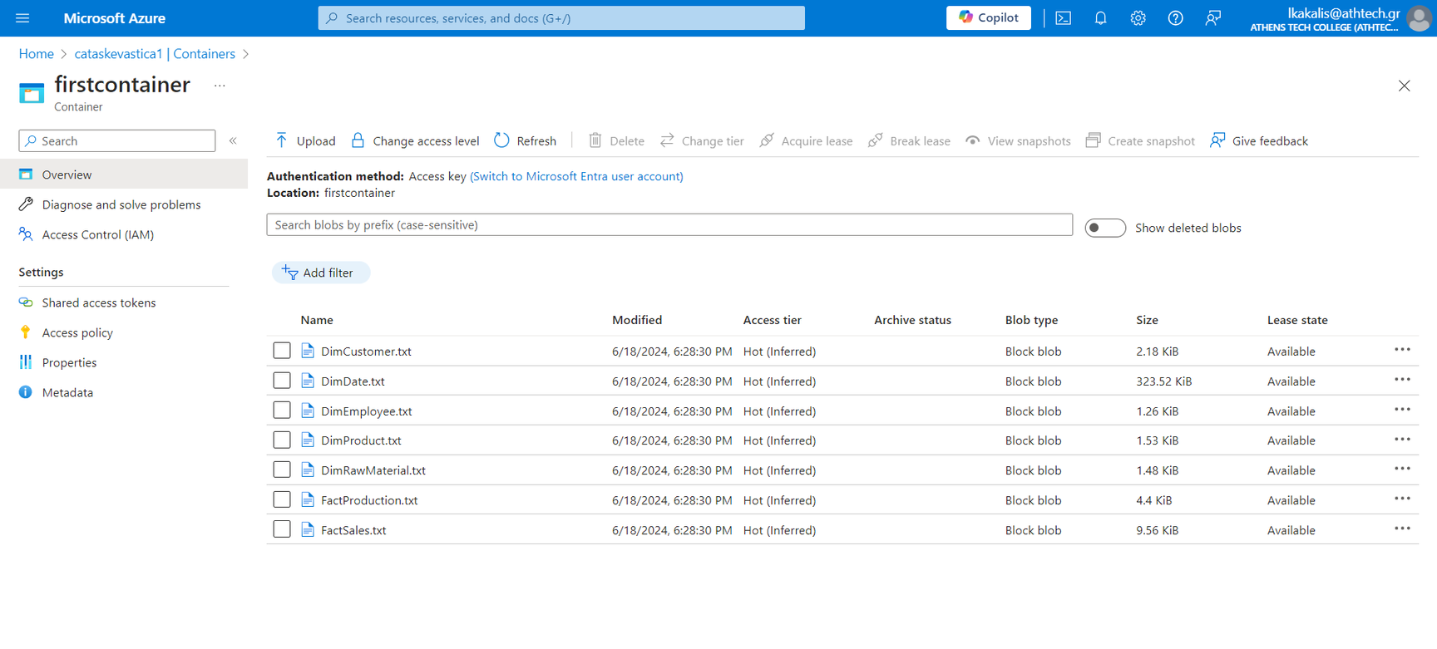
Azure Data Lake

Slide 11
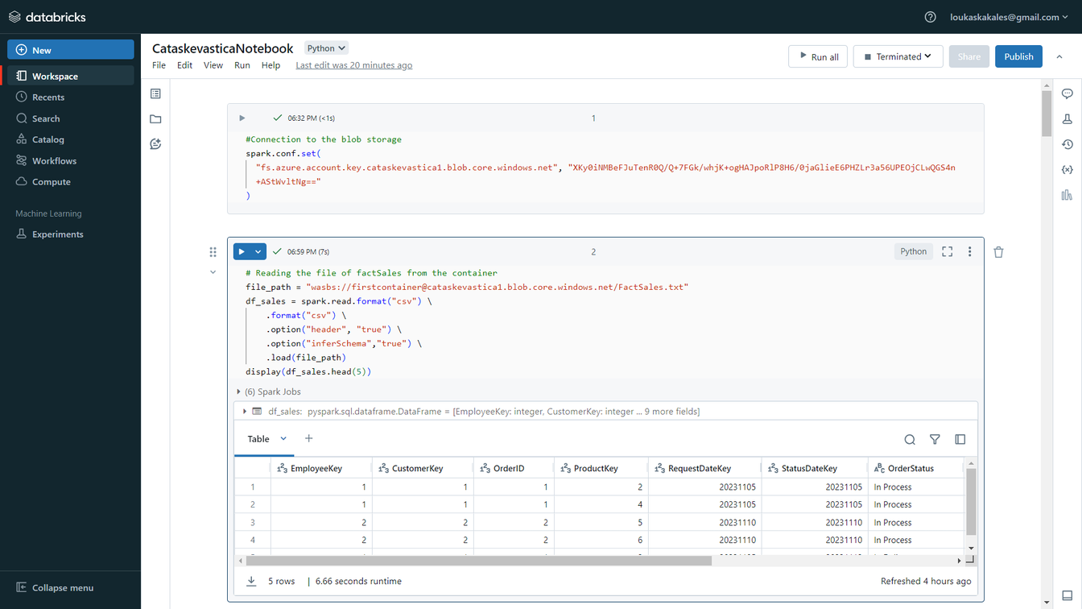
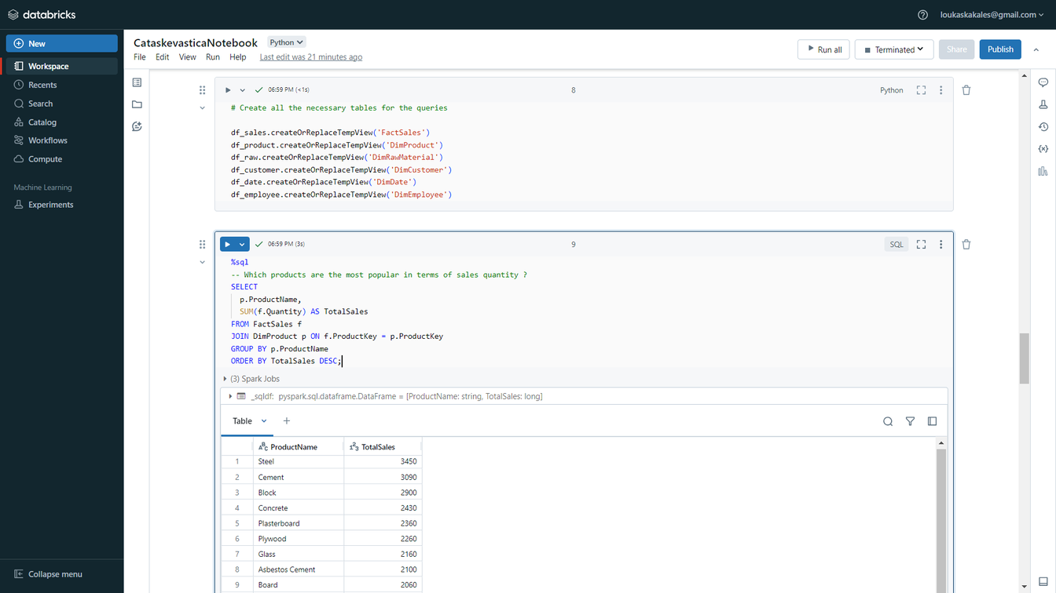
Azure Databricks

Slide 12
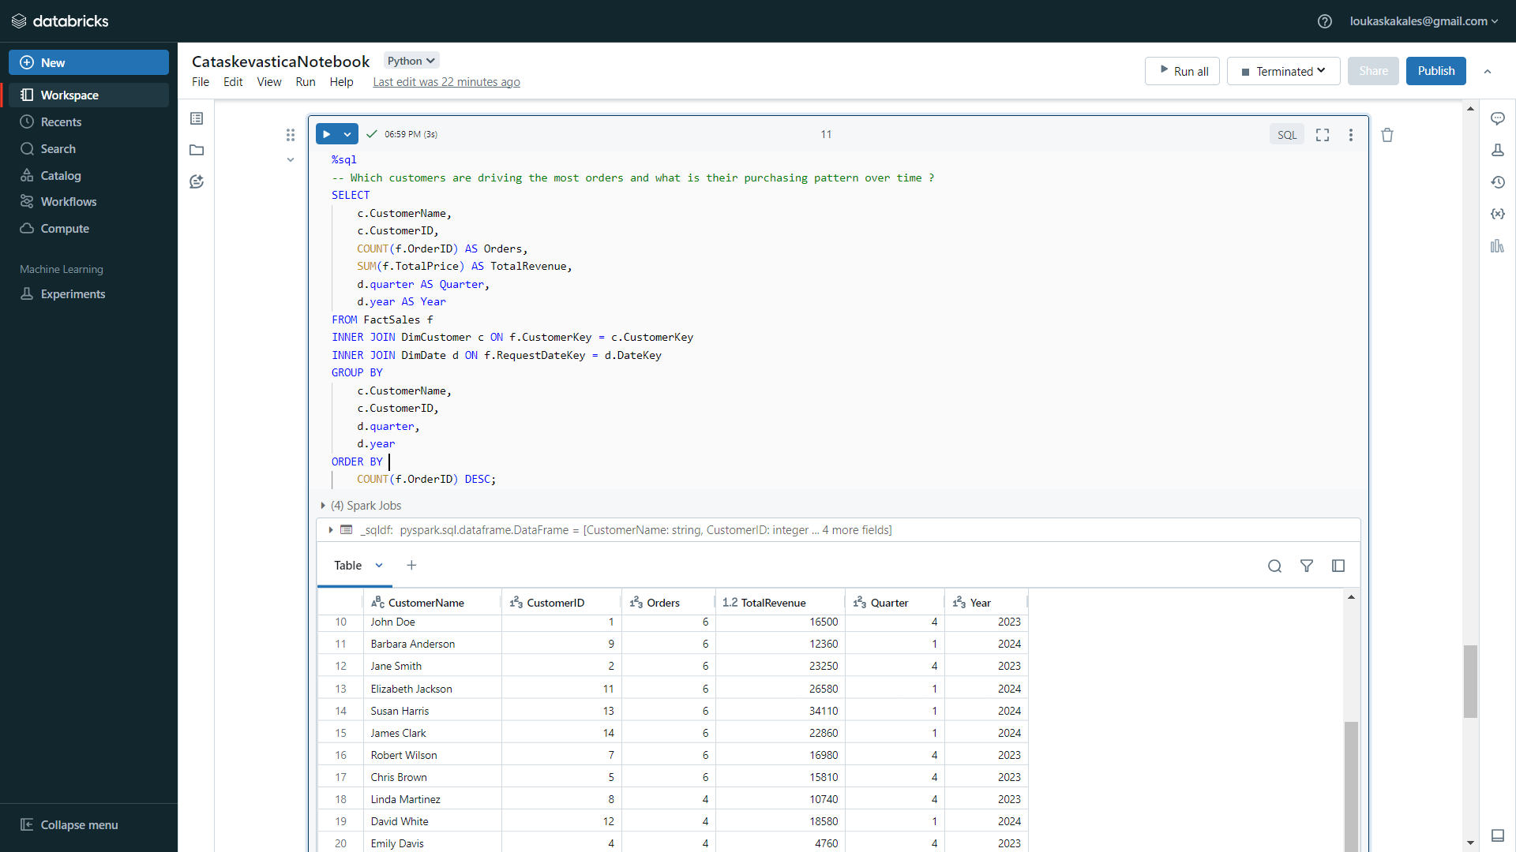
Azure Databricks

Slide 13
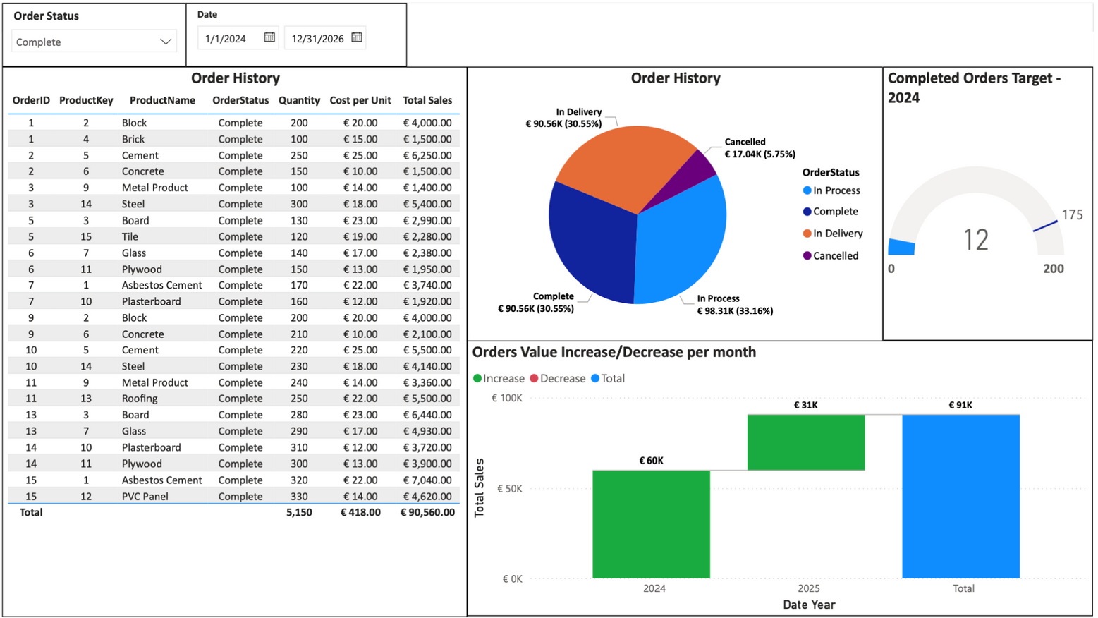
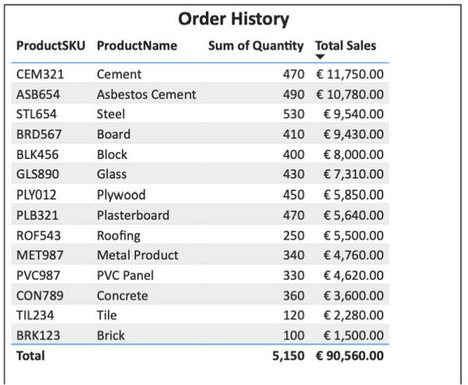
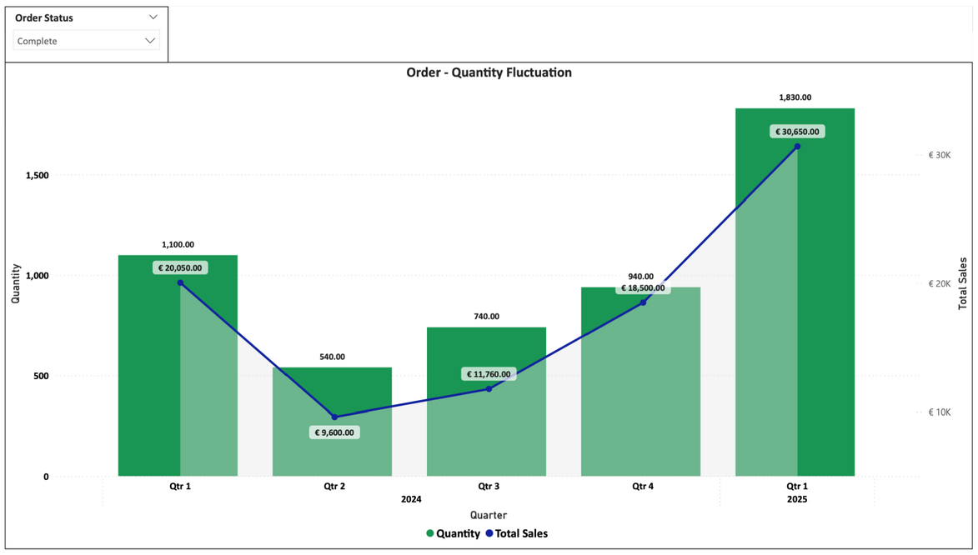

Power BI visualisation

Slide 14

Cataschevastica
Questions

Slide 15

Cataschevastica
Thank you!

